Slide 1

Renal Team Product Definition Canvas & Design Follow-up
Lisa Chen & James Bonaffini

Slide 2
Problem Statement
The purpose of this project is to decrease the incidence of peritonitis for current and future peritoneal dialysis (PD) patients by identifying infection in its early stages and refining/replacing the mechanics of existing PD devices.

Slide 3
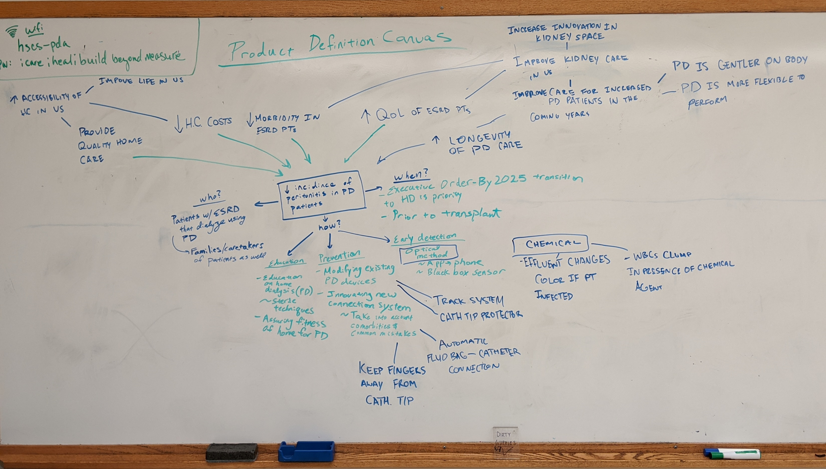

Slide 4
Renal Team Product Definition Canvas
Improve kidney care in the US
Improve life in the US
Improve care for increased PD PTs in the coming years
Increase accessibility of healthcare in the US
PD is gentler on the body and more flexible to do
Provide better quality home care
Decrease healthcare costs and forecasted utilization
Decrease morbidity in ESRD PTs
Increase QoL of ESRD PTs
Increase longevity of PD care
Patients with ESRD that dialyze using PD; caretakers/ families who assist
Who
Decrease Incidence of Peritonitis in PD Patients
When
Exec. Order – by 2025, transition to 80% of new patients; assimilated in 10 years
Education
Prevention
Early Detection
General
home dialysis and medical knowledge
Sterile techniques
Assure fitness of home for PD
Modify or work around existing PD devices
Innovate new connection system
Optical Method
Chemical Method
Track system for stay safe
Catheter tip protector
Keep fingers away from catheter tip
Automatic Fluid bag to Catheter connection
App – phone camera detector
Black box sensor
Effluent changes color if infected
WBCs clump if infected
US Kidney Care
Peritonitis Care
Methods

Slide 5
Design Thinking From 3/2: Escape
Bacteria doesn’t cause infections
Bacteria isn’t everywhere
Homes are always clean
P is an intuitive process
PD fluid doesn’t require tubes/organization into/out of peritoneum
Doesn’t need a catheter for PD
WBCs do not enter peritoneum or indicate infection
PD is always a viable dialysis option
Glucose is not a viable osmotic agent
PD Patients are perfect at performing PD
No need to drain/excrete fluid in dialysis
Peritoneum can regenerate fully
Catheters are not biocompatible/safe
Kidney doesn’t filter blood
Peritoneum transplant is better than kidney transplant
Peritoneum doesn’t become fibrotic from infection
Lack of sterile technique doesn't’ cause infection
Nephrons are replaceable
Other orange can filter blood better than the kidney
There is no peritoneum
Body can not produce infection
PD is not gentle
Don’t need access to internal cavity/ organize for PD
Gravity is not real/can not pull glucose in/drain out
PD is just as effective as kidneys
Everyone has good dexterity and perfect vision

Slide 6
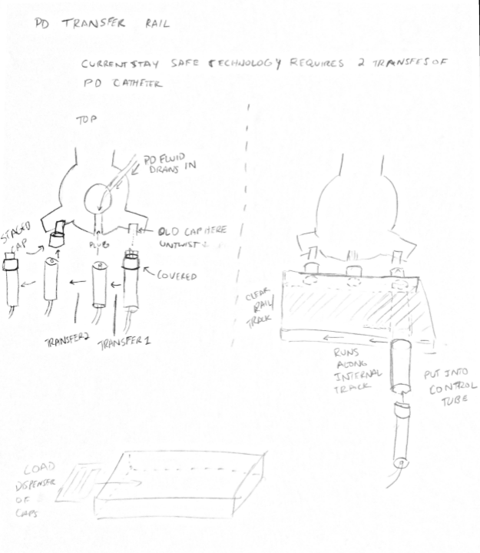
Design Sketches – Transfer Rail

Slide 7
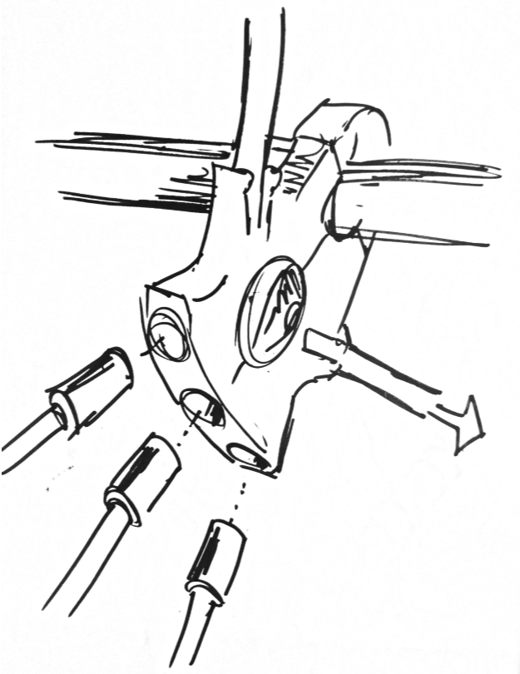
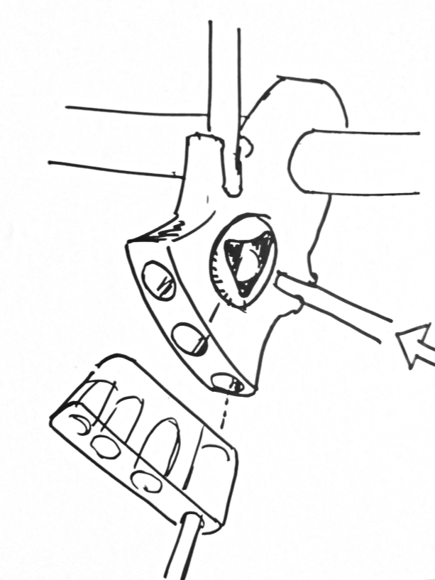
Design Sketches – Transfer Rail

Slide 8
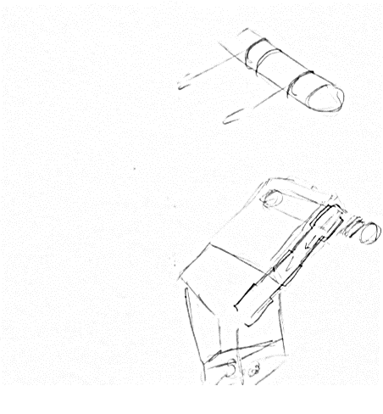
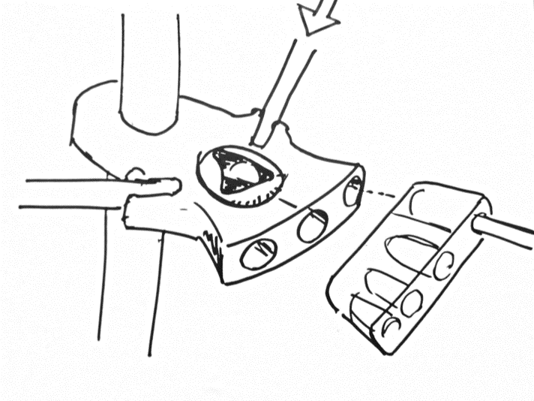
Design Sketches – Transfer Rail
Has rails to track inside the transfer rail case
Catheter holder,
Firmly holds catheter to allow for twisting
Is inserted into transfer rail case
Transfer Rail Case
Magazine for extra tips

Slide 9
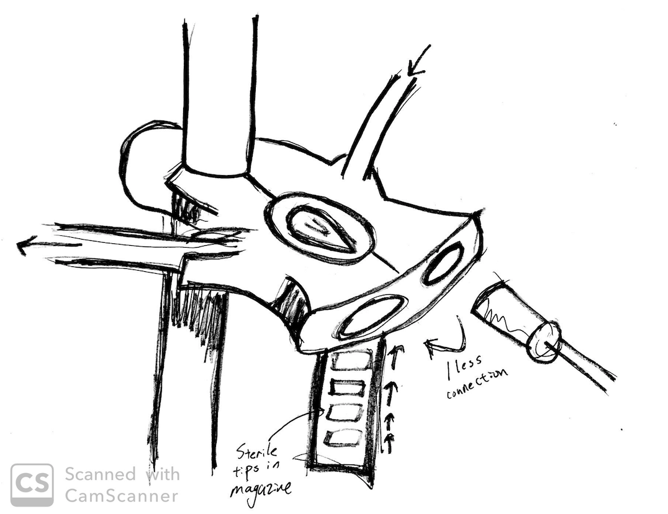
Design Sketches -- 3 to 2

Slide 10
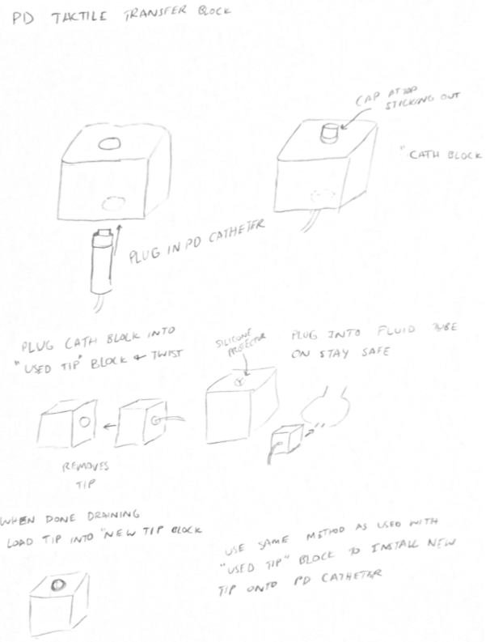
Other Design Sketches – Transfer Blocks

Slide 11
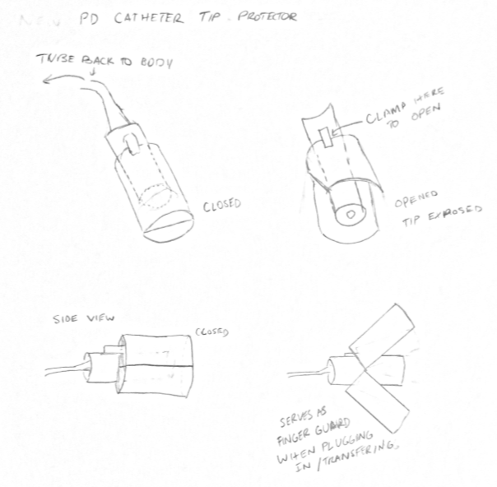
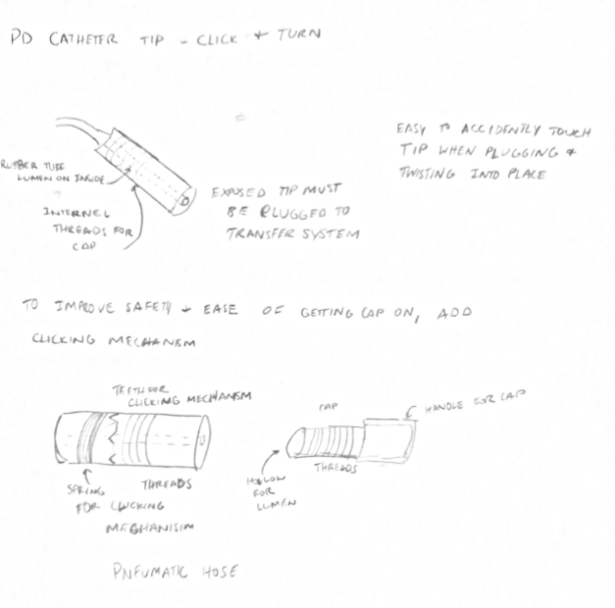
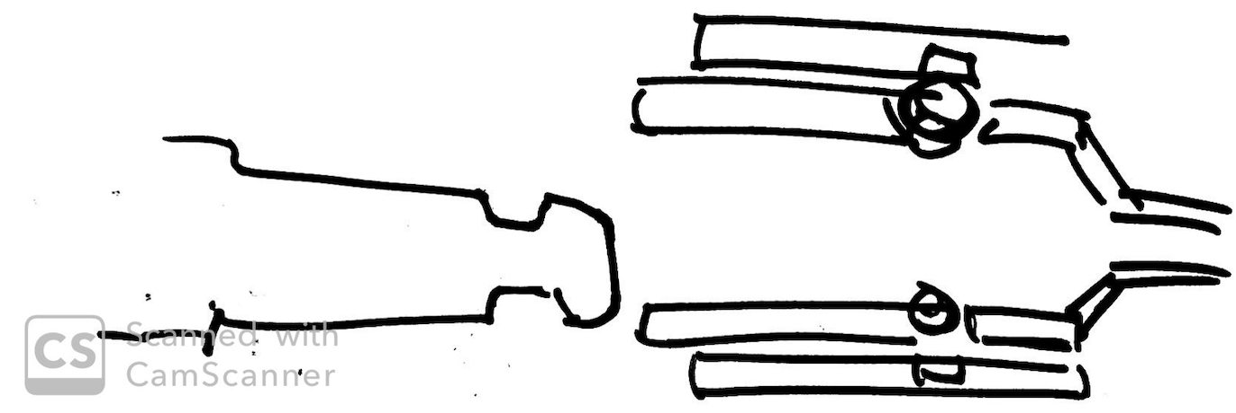
Other Design Sketches – Catheter Tip
Magnetic ball bearing connection

Slide 12
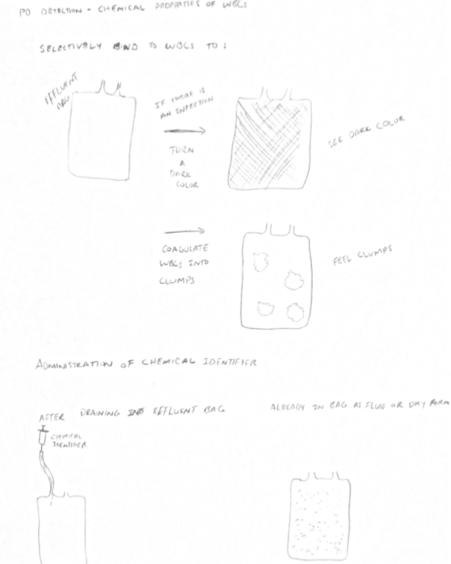
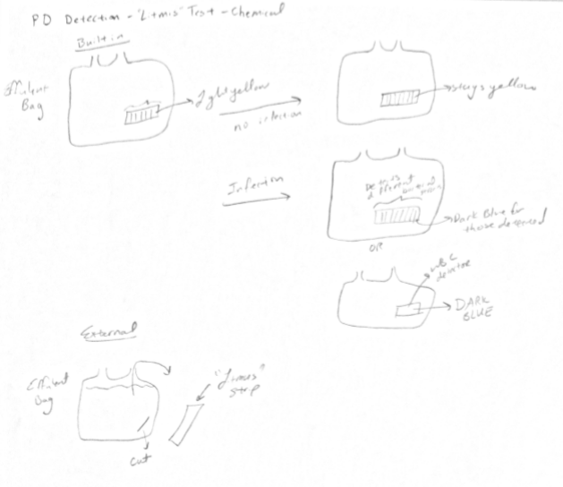
Other Design Sketches - Detection

Slide 13
Other Design Sketches - Detection

